Slide 1
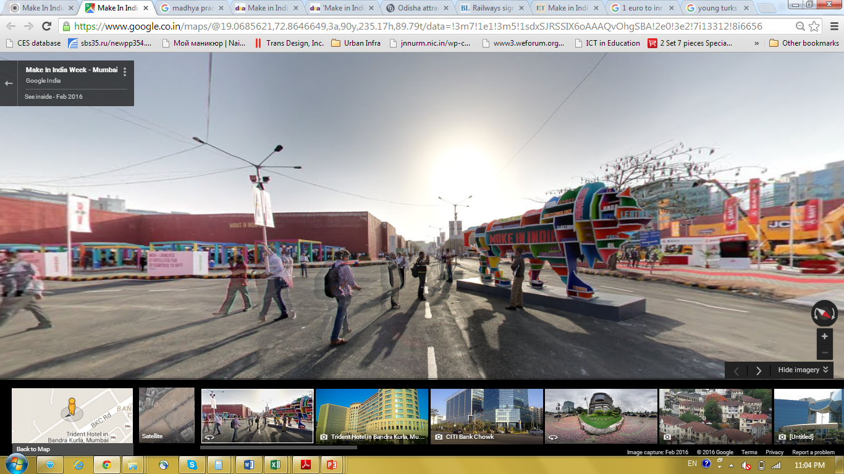
MAKE IN INDIA WEEK 2016

Slide 2
The biggest showcase of
India’s manufacturing prowess
Created avenues for showcasing, connecting and collaborating for manufacturing in India
Promoted Investment enabling environment and healthy competitive spirit amongst States
Encouraged Design, Innovation, Youth and Startups
A platform where global CEOs, think tanks, policy makers, Diplomats and Political leaders converged

Slide 3

Make in India Week at an all-time high!
> 15,20,000
1,05,000
Crore Investment committed
Crore of Business Enquiries
8,90,000
150
Events under Make in India Week
Visitors
102
1,245
Speakers – National and International
Countries represented
215
8,245
B2B,B2G and G2G meetings
Exhibitors

Slide 4
Participation
PMs, Deputy PM and Foreign Ministers | 20
Government of India Ministers | 13
Chief Ministers and State Ministers | 15
CEOs and CXOs | 1,000
Indian companies | Over 9,000
Foreign Companies | Over 2,000
Foreign Delegates | Over 4,000

Slide 5
EVENTS (Seminars, Knowledge sharing sessions, Other activities)
Number of events under Make in India Week | 150
Events in Make in India Centre | 52
Total number of speakers | 1,245
Participants in events and seminars at MIIC | 65,500

Slide 6
B2B / B2G / G2G Meetings
Business – to – Business | 6,800
Business – to – Government | 1,400
Government – to – Government | 45

Slide 7
KEY DEALS DURING THE WEEK
Sterlite Group company TwinStar Display Technologies & MIDC for LCD manufacturing unit in technical collaboration with Autron of Taiwan
BAE Systems and Mahindra for assembling and testing of M777 Howitzers
ORACLE’s USD 400 million investment in India to set up 9 incubation center
Trivitron healthcare manufacturing unit in Chennai
Gujarat Government and Vestas (Denmark) for wind mill blades manufacturing unit at Ahmedabad
Raymond Industries to invest Rs. 1400 crore for manufacturing linen yarn and fabric facility

Slide 8
KEY DEALS DURING THE WEEK
Mahindra & Mahindra: Investment – Rs. 8000 crores (Nashik: Rs. 6500 crores, Chakan – Rs. 1,500 crore)
Gujarat Government and Tar Kovacs Systems (France) for offshore platform to develop marine applications in Gujarat
Tar Kovacs and Government of Karnataka for setting up ocean based renewable energy project
Yes Bank and IREDA for financing of renewable power projects
Ascendas | Investment: Rs. 4571 crore | Employment: 1.09 Lakh

Slide 9
KEY DEALS DURING THE WEEK
Mercedes | Investment: Rs. 1500 crore | Employment: 4270
Rashtriya Chemicals and Fertilizers | Investment: Rs. 6204 cr | Employment: 140
Godrej Industries| Investment: Rs. 3000 cr | Employment: 2000
JSW Jaigarh Port Ltd | Investment: Rs. 6000 crores | Employment: 1000
CREDAI and MCHI for 5.7 Lakh affordable homes with an investment of Rs.1.1 lakh crore and 7.6 lakh jobs

Slide 10
KEY DEALS DURING THE WEEK
Government of Jharkhand and Vedanta Ltd
Government of Jharkhand and Adani group to set up a thermal power plant with a total capacity of 1,600 MW to be supplied to Bangladesh Grid
Agreement between Government of Jharkhand and Adani Group to set up a Coal based Methane fertilizer plant
Uber and Skill Development and Entrepreneurship Department (SDED) of the Maharashtra government
Solar Industries and Government of Maharashtra to set up a Nagpur plant for manufacturing of ammunition for armed forces

Slide 11
POLICY / INVESTMENT PLANS ANNOUCEMENTS
SECTOR SPECIFIC
Electronics Development Fund (EDF) worth ~USD 350 million (INR 2,200 crore) launched
Capital Goods Policy 2016 introduced
Investment Opportunities in Infrastructure and Industries in India
Investment Opportunities in Food Processing
Ease of Doing business measures for Food Processing and MSME sectors
E-toll initiative for highways in India

Slide 12
POLICY / INVESTMENT PLANS ANNOUCEMENTS
STATE SPECIFIC
Maharashtra | Maharashtra Retail Policy Single Window Policy Maharashtra Maritime Industrial Policy Electronics Policy with FAB manufacturing Special Package for SC/ST Entrepreneurs
Odisha | Odisha Industrial Development Plan 2025, and E-business Platform
Jharkhand | Jharkhand Industrial Promotion Policy 2016
Karnataka | Key schemes of Industrial Policy and Startup Policy

Slide 13
PROMOTION OF YOUTH, STARTUPS, DESIGN & INNOVATION
QPRIZETM | On Spot prize of Rs. 2 crore by Qualcomm for Startups in India
Hackathon | A platform for innovators, programmers and engineers. Awarded teams from top engineering institutions in India
Create in India for the World | Showcased stories of young entrepreneurs who have designed, innovated and built in India
Empowering through Design | Promoted India as a center for global design
Champions in Societal Manufacturing | Showcased futuristic initiatives for manufacturing in India
TIME India Awards | Awards to top 3 Manufacturers in India

Slide 14
Make in India Centre
Number of halls | 27
Number of exhibited sectors | 11
Number of exhibitors | 215
Number of state and UT pavilions | 17
Number of country pavilions | 3

Slide 15
Make in India Centre
Total gross area | 2,30,000 sq. m
Total Exhibition Area | 5,00,000 sq. ft
Total Façade Area | 3,50,000 sq. ft
Open Areas | 1,00,000 sq. ft
Road infrastructure with paver blocks | 2,00,000 sq. ft
Skilled Manpower Involved | 5,500

Slide 16
MAKE IN INDIA MITTELSTAND (MIIM)
SME Focused program to attract German SMEs to India
Mittelstand (German) companies enrolled for the programme
Several MIIM companies completed major steps for making investments in India
Two workshops conducted successfully in presence of more than 45 companies
More than 50 meetings conducted with Mittelstand companies

Slide 17
Make in India Week - Way Forward
Striving to provide investment enabling environment to Foreign and Domestic investors
Promoting quality jobs through development of innovation and design ecosystem
Forging partnerships for manufacturing sector development for enabling “Champions States for Manufacturing”
Enabling environment for Startups and SMEs to scale up their operations
Active cooperation with States for promoting manufacturing across all States in India and remotest part of the country
Promoting Industry and Academia linkages for joint research and product development to drive frugal engineering

Slide 18


